Slide 1
Week Four Methods
The CSC313 Team
[2023|2024]

Slide 2
What is a Method?
Methods can be used to define reusable code and organize and simplify coding.
A method is a collection of statements grouped together to perform an operation.
There are predefined methods in Java, such as System.out.println and others.

Slide 3
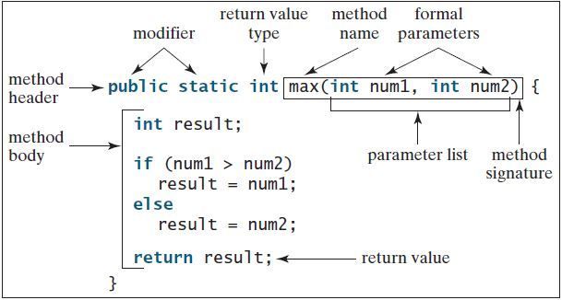
What is a Method?
A method definition consists of its method name, parameters, return value type, and body

Slide 4
What is a Method?
The Method header specifies the modifier, return value type, method name and its parameters.
The return value type is the data type the methods would return. Such methods are called value-returning methods.
Not all methods return values. For a method that doesn’t return any value, the keyword void is used in place of a return value type

Slide 5
What is a Method? (Cont’d)
The variables in the header are parameters that would receive values when the method is invoked or called. The value received is also called an argument.
The method name and parameters consist the method signature.
A method may or may not have a parameter, parameters are optional. E.g. Math.random()
The method body contains the collection of statements that implement the method

Slide 6
Types of Methods
Methods with a return value type
E.g. public static int max (int i, int j);
Methods without a return value type
E.g. public static void printGrade(double score);
They are called in different ways in a program.

Slide 7
Calling Methods
Methods with a return value type
These methods are treated as a value when called
E.g. int larger = max(3.5); //max returns a value
Methods that return voids
These methods are called as statements
E.g. printGrade(65); //printGrade(x) does not return any value

Slide 8
Example of a Return value type Method
public class TestMax { public static void main(String [] args) { int i = 5; int j = 2; int k = max(i, j); JOptionPane.showMessageDialog(null, "The maximum of " + i + " and " + j + " is " + k); } public static int max(int num1, int num2) { int result; if (num1 > num2) result = num1; else result = num2; return result; } }

Slide 9
Example of a void Method
public class TestVoidMethod { public static void main(String [] args){
printGrade(78.5); printGrade(59.5); }
public static void printGrade(double score){ if (score >= 90.0) JOptionPane.showMessageDialog(null,"The grade is A"); else if (score >= 80.0) JOptionPane.showMessageDialog(null,"The grade is B"); else if (score >= 70.0) JOptionPane.showMessageDialog(null,"The grade is C"); else if (score >= 60.0) JOptionPane.showMessageDialog(null,"The grade is D"); else JOptionPane.showMessageDialog(null,"The grade is F"); } }

Slide 10
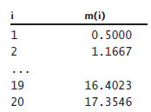
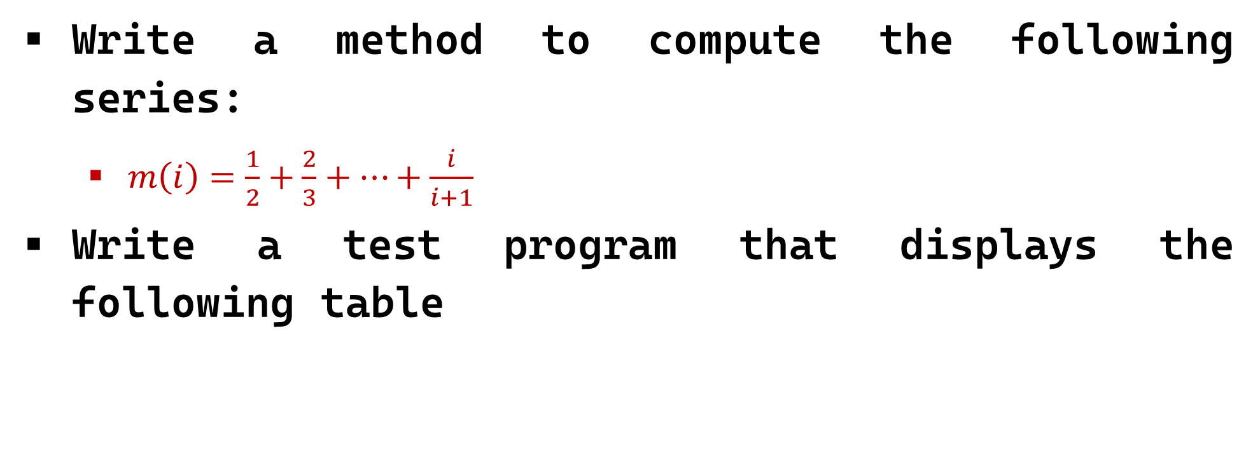
Classwork 1
Write a method to compute the following series:
$m\left(i\right)=\frac{1}{2}+\frac{2}{3}+…+\frac{i}{i+1}$
Write a test program that displays the following table

Slide 11
Solution to Classwork 1
public class Series { public static void main(String [] args){ // Display table series data between 1.0 to 20.0 double seriesStart = 1.0; // Start range double numberOfRows = 20.0; // End range // Display Data for (double i = seriesStart; i <= numberOfRows; i++) { String Series = String.format("%-10.0f", i); JOptionPane.showMessageDialog(null,Series); String Series1 = String.format("%7.4f\n", sumSeries(i)); JOptionPane.showMessageDialog(null,Series1); } }

Slide 12
Cont’d Solution to Classwork 1
public static double sumSeries(double n) { double sum = 0; // Sum of the series for (double i = 1; i <= n; i++) { sum += i / (i + 1); } return sum; } }

Slide 13
Methods Overloading
Method overloading means multiple methods can have the same name with different parameters.
Instead of defining two methods that should do the same thing, it is better to overload one.
Multiple methods can have the same name as long as the number, sequence and/or type of parameters are different.

Slide 14
Method Overloading example
public class MethodOverload { static int plusMethod(int x, int y) { return x + y; } static double plusMethod(double x, double y) { return x + y; } public static void main(String[] args) { int myNum1 = plusMethod(8, 5); double myNum2 = plusMethod(4.3, 6.26); JOptionPane.showMessageDialog(null, "int: "+myNum1); JOptionPane.showMessageDialog(null, "double: "+myNum2); } }

Slide 15
Overloading methods (2) – different number of arguments
static void computeArea(double l, double b) { double area = l * b; JOptionPane.showMessageDialog(null, "Result is " +area); } static void computeArea(double l, double b, double h) { double area = l * b * h; JOptionPane.showMessageDialog(null, "Result is " +area); } public static void main(String[] args) { computeArea(4, 3.5); // call the first version computeArea(4, 9, 2.5); // call the second version } }

Slide 16
Classwork 2
Write a java program that overloads a method max with int and double types to return the largest of any three integer numbers or any three floating point numbers.

Slide 17
Exercises (1)
(Display patterns) Write a method to display a pattern as follows:
1
2 1
3 2 1
...
n n-1 ... 3 2 1
The method header is
public static void displayPattern(int n)

Slide 18
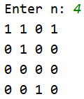
Exercises (2)
(Display matrix of 0s and 1s) Write a method that displays an n-by-n matrix using the following header:
public static void printMatrix(int n)
Each element is 0 or 1, which is generated randomly. Write a test program that prompts the user to enter n and displays an n-by-n matrix. Here is a sample run:

Slide 19
Exercises (3)
(Occurrences of a specified character) Write a method that finds the number of occurrences of a specified character in a string using the following header:
public static int count(String str, char a)
For example, count("Welcome", 'e') returns 2.
Write a test program that prompts the user to enter a string followed by a character and displays the number of occurrences of the character in the string.

Slide 20

Exercises (4)
In Exercise 3, the expression count("Welcome", ‘w’) returns 0.
Enhance your program in Exercise 3 to count accurately regardless of the letter case.
Sample output shown below

